Slide 1

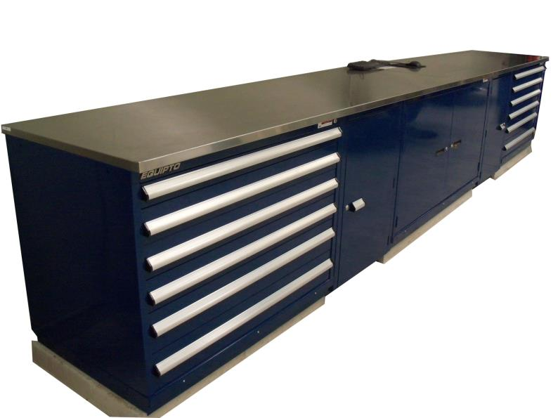


Slide 2
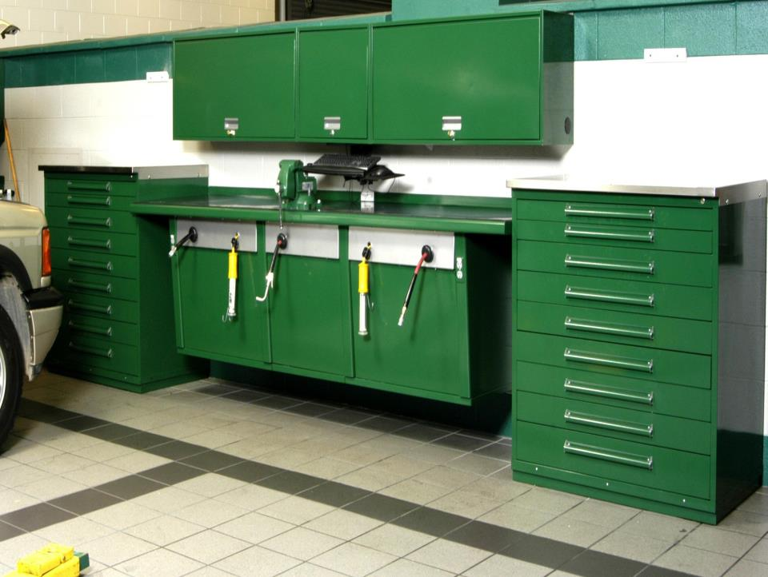
WORKBENCH WALL MOUNTED

Slide 3
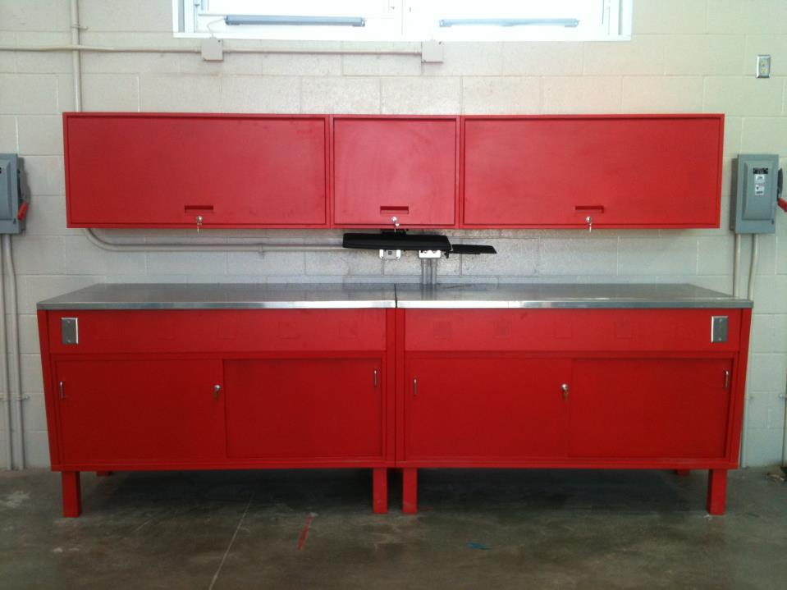

Slide 4
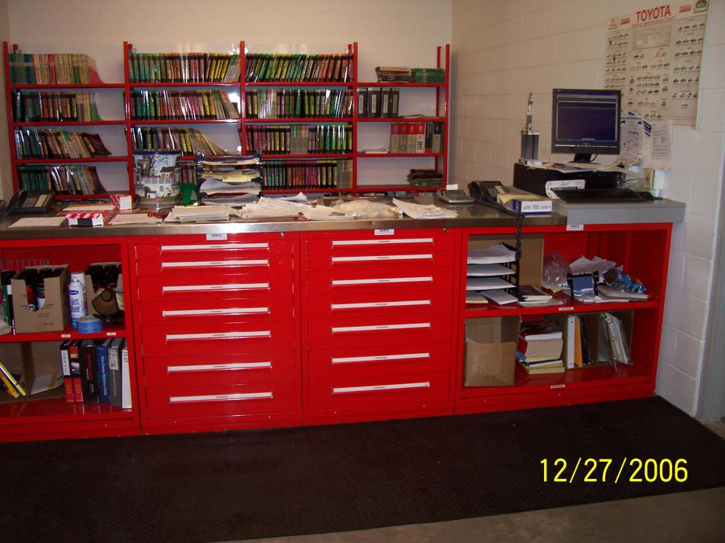

Slide 5
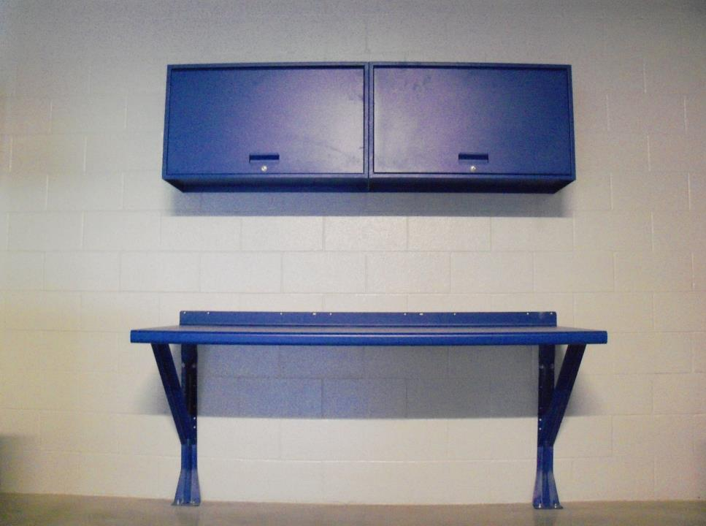

Slide 6
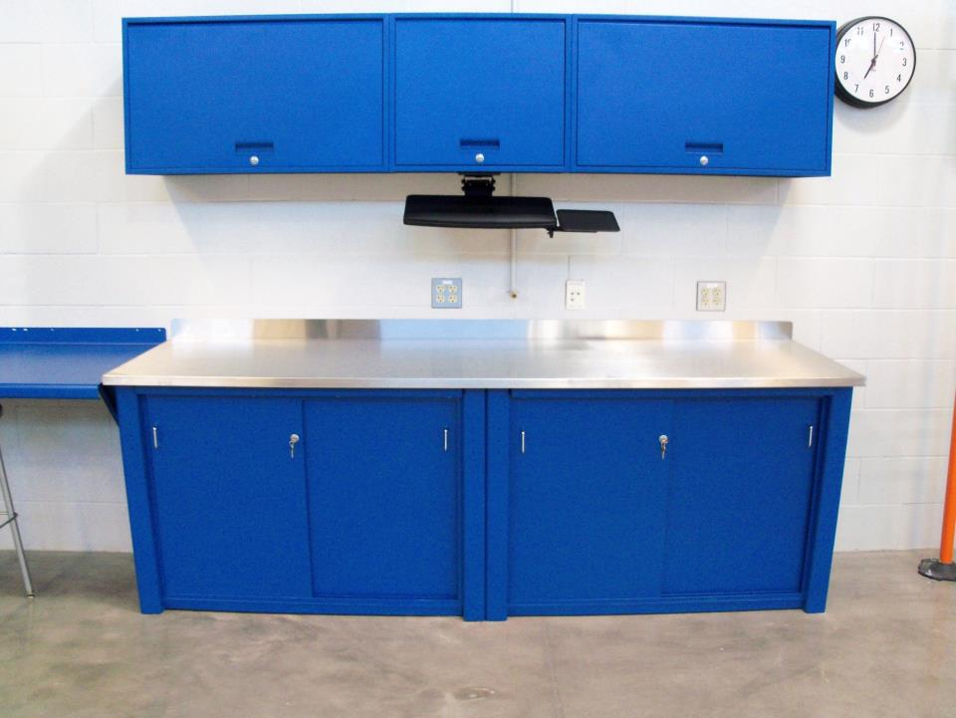

Slide 7
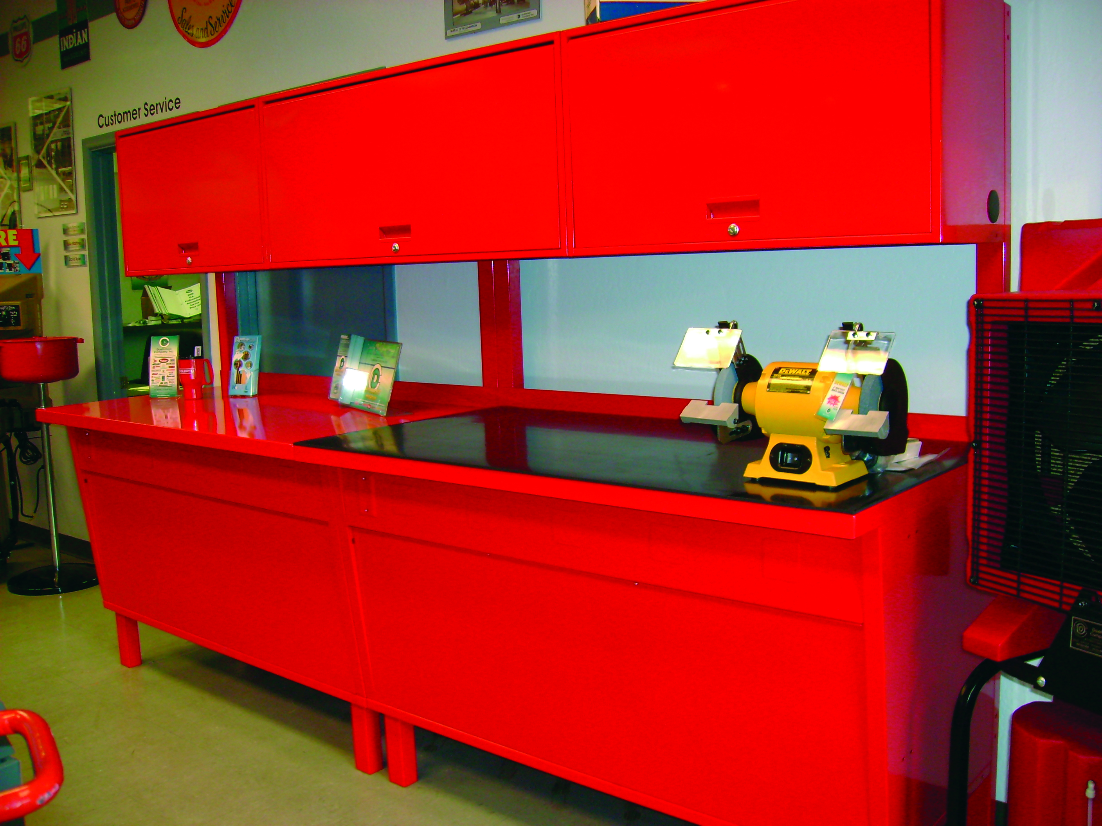
WALL MOUNTED OR FREE STANDING
FREE STANDING SHOWN

Slide 8
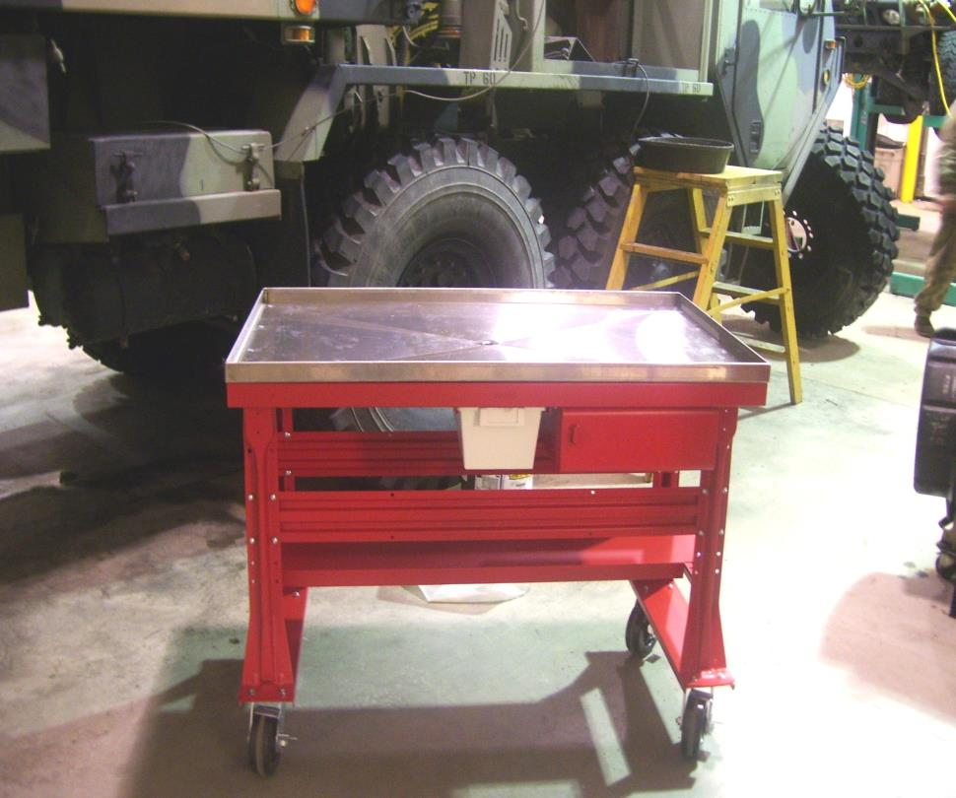
TEARDOWN BENCH
LOCKABLE DRAWER
FLUID COLLECTION PAN

Slide 9
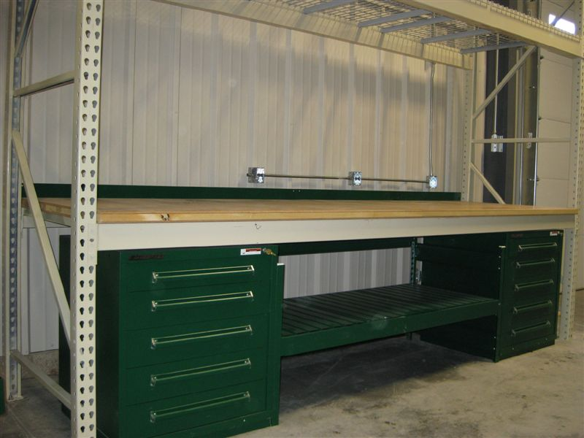
CUSTOM CONFIGURATION TO MEET
YOUR EXACTING REQUIREMENTS

Slide 10
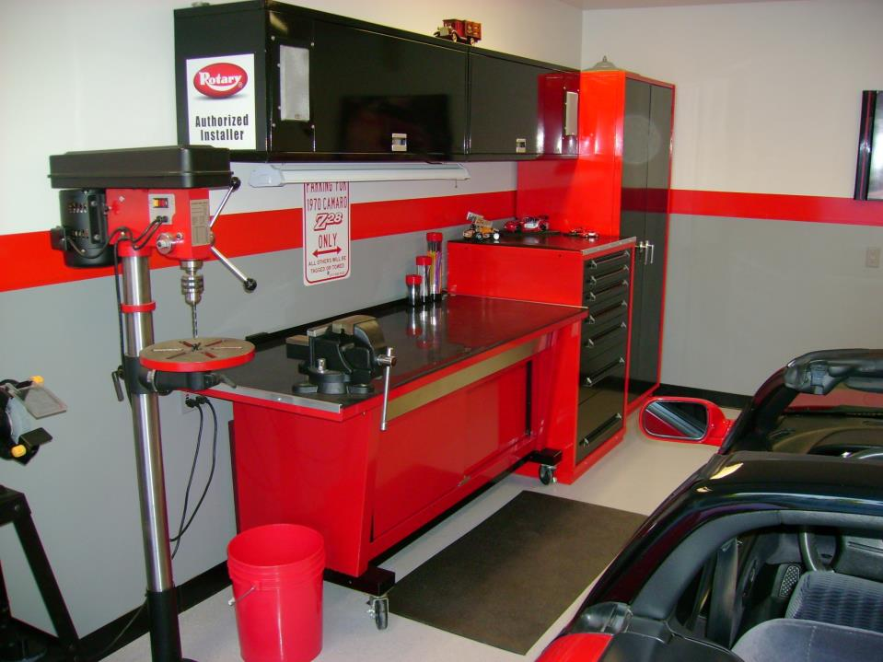
PORTABLE WORKBENCH,
1200 LB CAPACITY

Slide 11
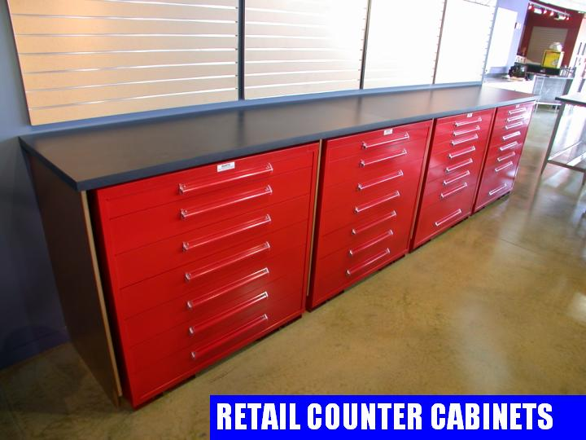

Slide 12
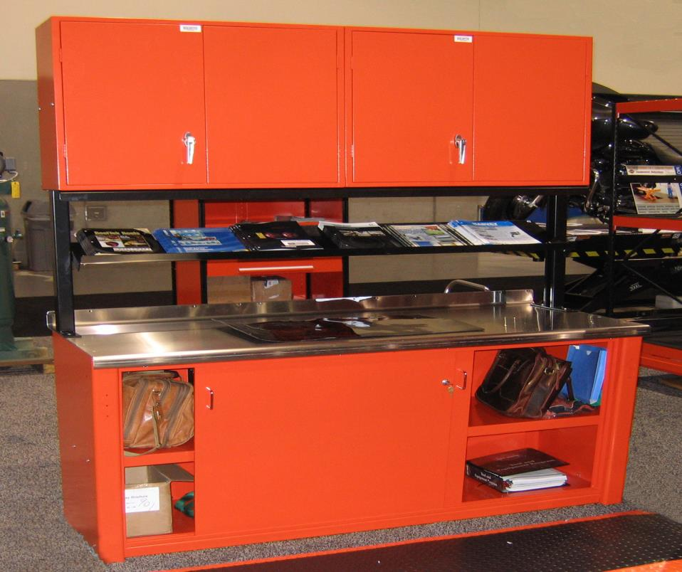
INVERTED HANDLES FOR EASY REACH
MID SHELF ADJUSTABLE TO OBTAIN ANGLE REQUIRED
STAINLESS STEEL TOP
LOCKABLE SLIDING DOORS

Slide 13
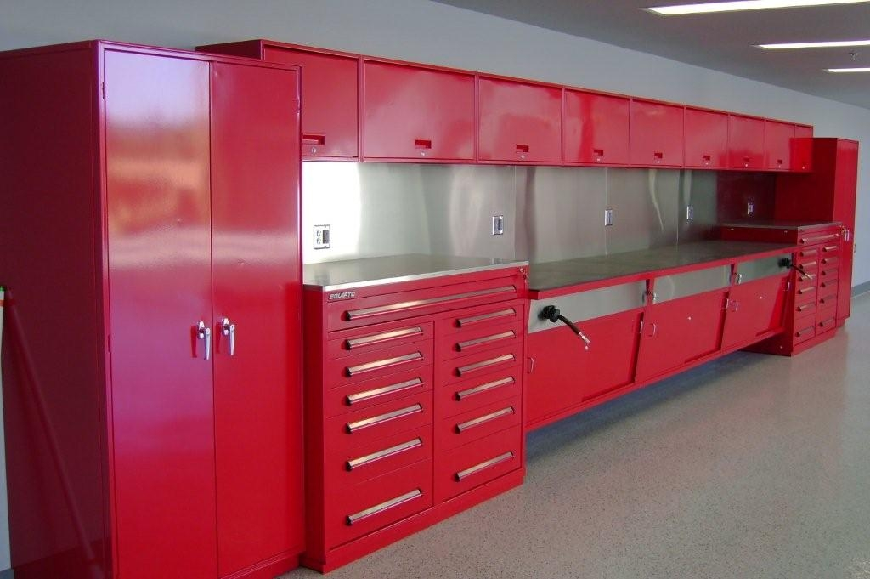

Slide 14
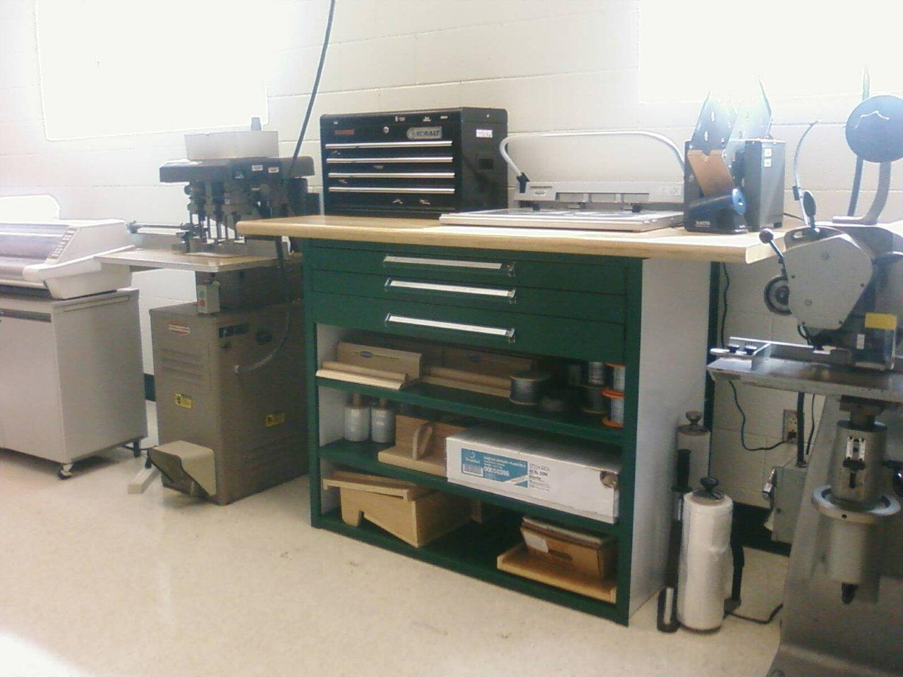

Slide 15
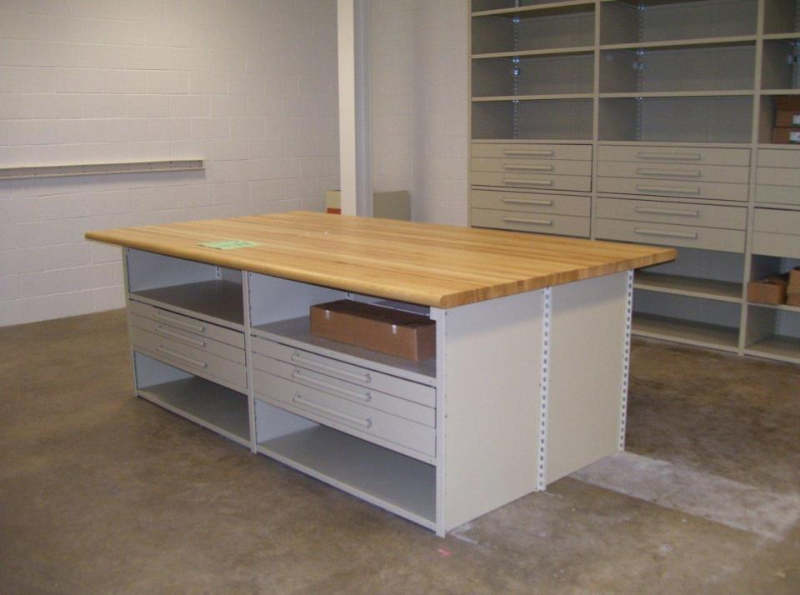
V GRIP SHELVING WORK CENTER,
ADD DRAWERS, SHELVES, DOORS, ETC
EVER CHANGING TO MEET YOUR FUTURE
REQUIREMENTS.

Slide 16
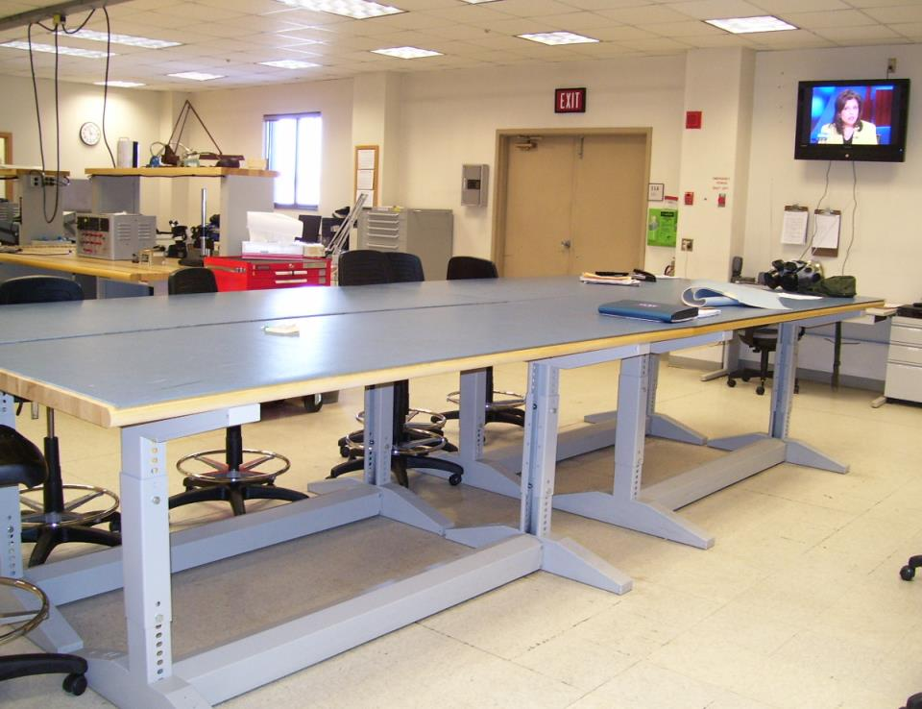
IRON I WORK CENTERS
ADJUSTABLE HEIGHT @ ½” INCREMENTS

Slide 17
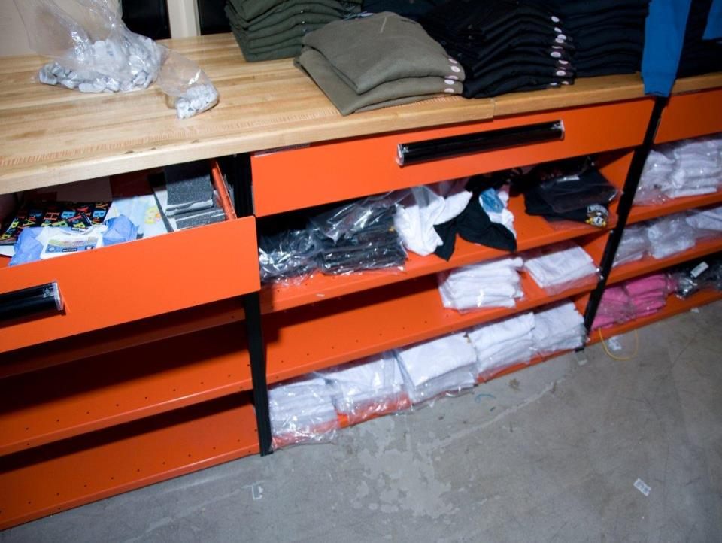
ADD DRAWERS, DIVIDERS, DOORS
INTO THE FUTURE

Slide 18
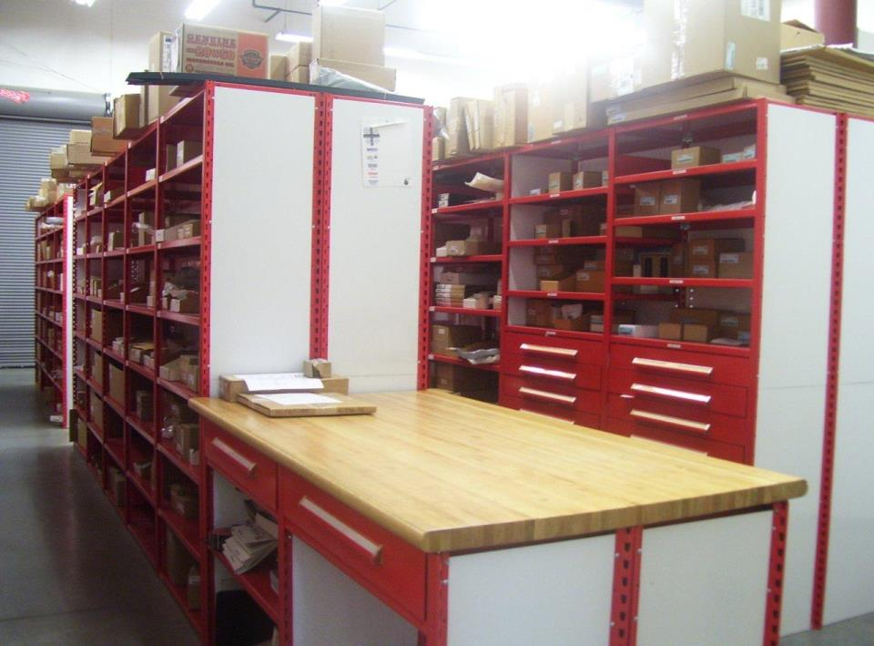

Slide 19
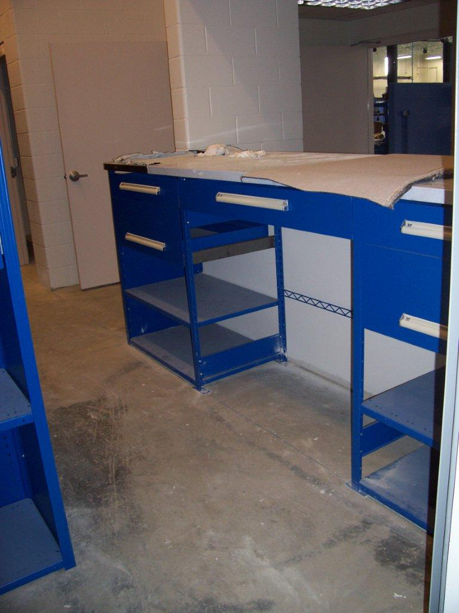

Slide 20
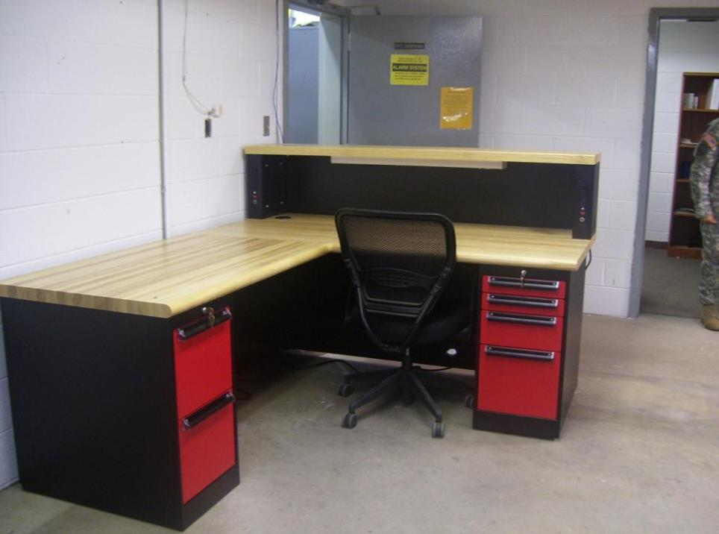

Slide 21
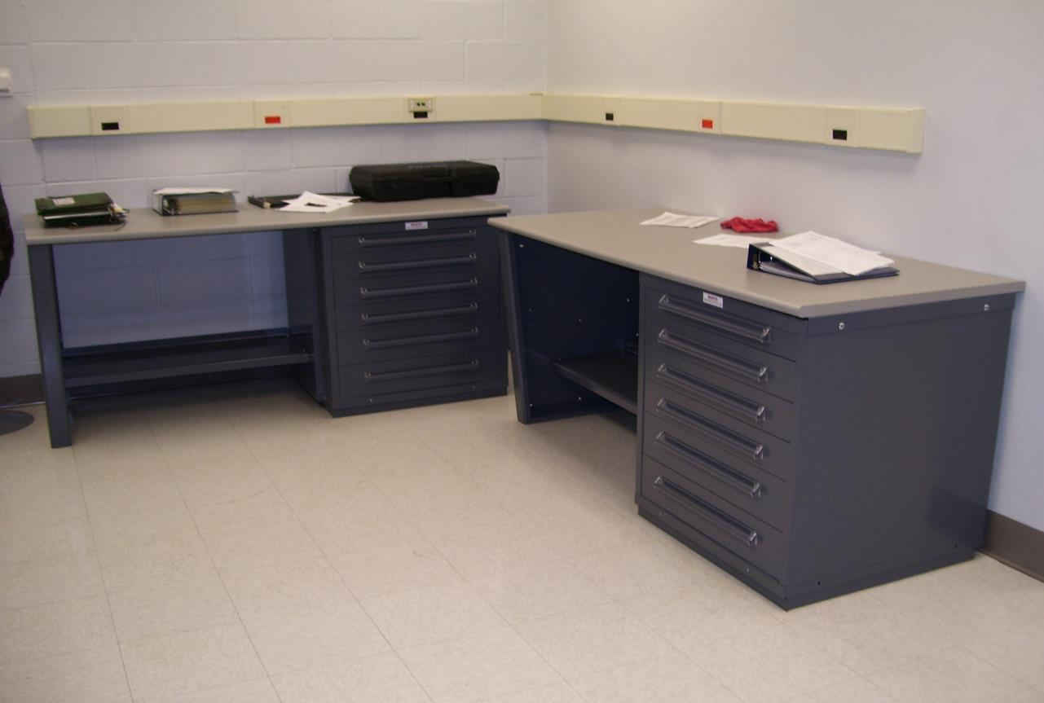
MODULAR CABINET WORK CENTERS
400 LB CAPACITY DRAWERS

Slide 22
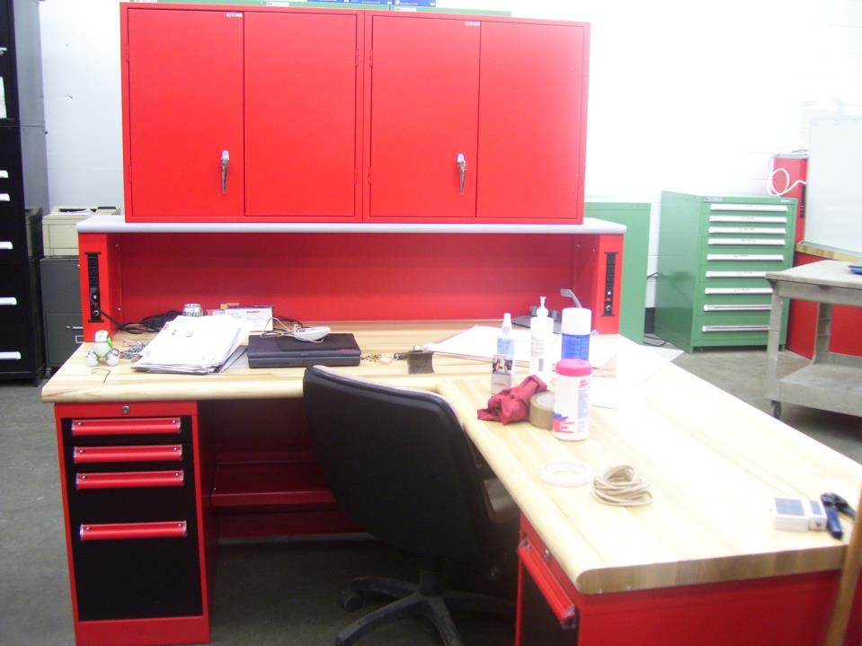

Slide 23
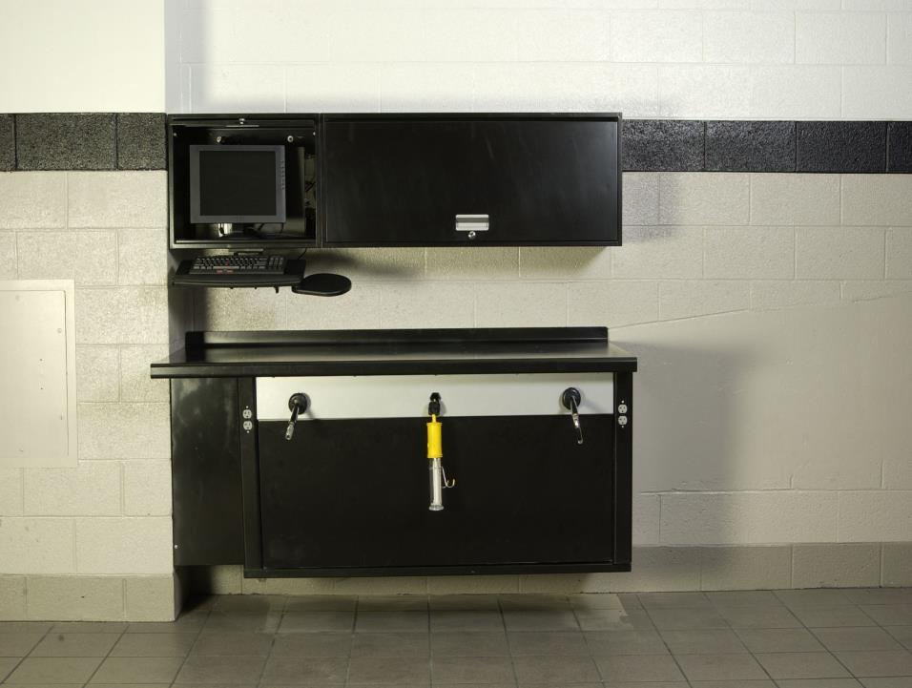
HOSE REELS HIDDEN INSIDE
WORK BENCH

Slide 24
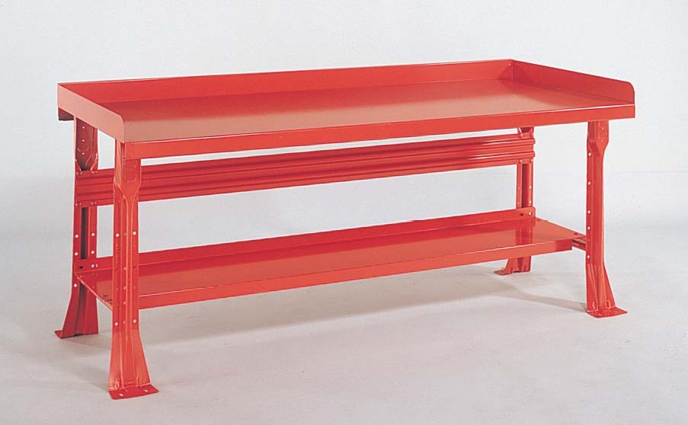
OPEN LEG WORK CENTERS, AVAILABLE WITH STAINLESS STEEL TOPS, BONDED WOOD,
STEEL TOP, HARDWOOD, PLASTIC LAMINATE & ANTI STATIC.
ORDER WITH OR WITHOUT SIDE & BACK RAILS

Slide 25
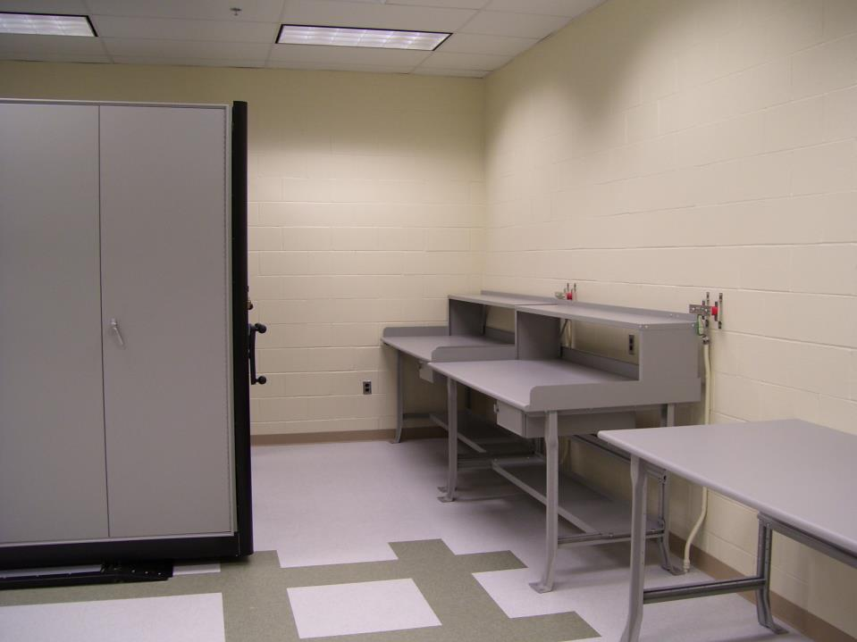
NJ ARNG CSMS
TMDE Calibration Room
14” HIGH STEEL AERIAL SHELVES
LOCKABLE DRAWERS

Slide 26
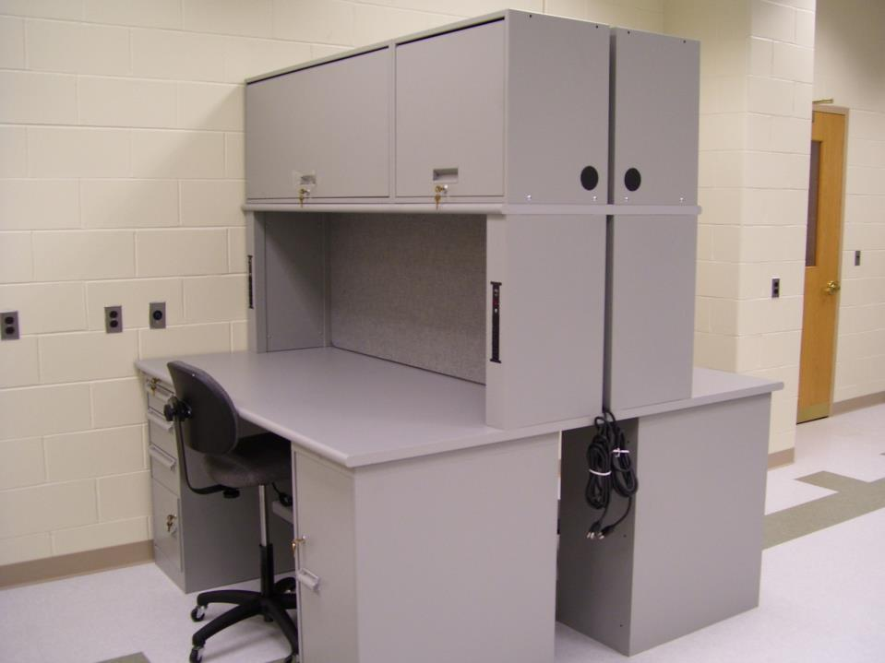
DOORS RECESS OUT
OF VIEW
6 WORK SURFACES
AVAILABLE
TACK BOARD
120 VAC

